Slide 1
Predicting the best location for Indian restaurant

Slide 2
Predicting best location for Indian restaurant in Toronto City
Location plays an important role in opening a restaurant.
Data was analyzed to find the locality having minimum number of Indian restaurants.

Slide 3
Data acquisition and cleaning
List of Borough and Neighbourhood were scraped from https://en.wikipedia.org/wiki/List_of_postal_codes_of_Canada:_M
Geopatial data was taken from https://cocl.us/Geospatial_data.
The list of Indian restaurants and their ratings were fetched using Foursquare API.

Slide 4
Data acquisition and cleaning Contd..
Rows with Borough as ‘Not Assigned’ were ignored.
Neighbourhoods under same Boroughs were combined together.
There were total 103 rows and 3 columns

Slide 5
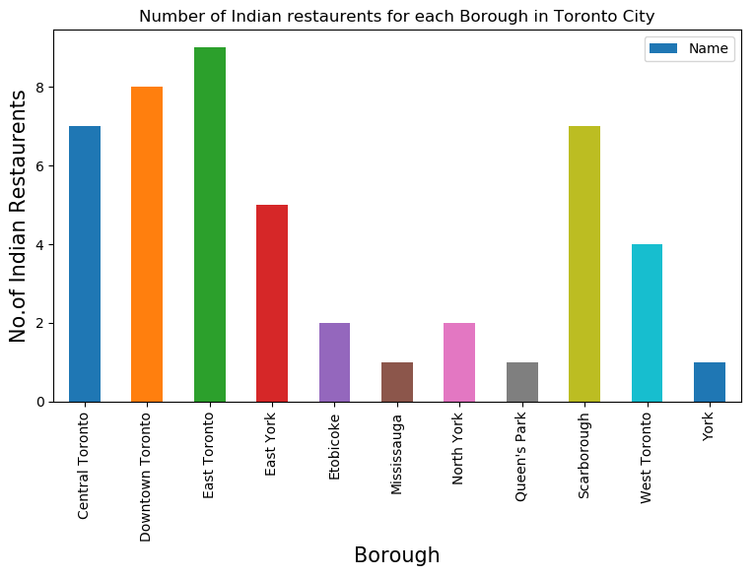
Boroughs having minimum number of Indian restaurants

Slide 6
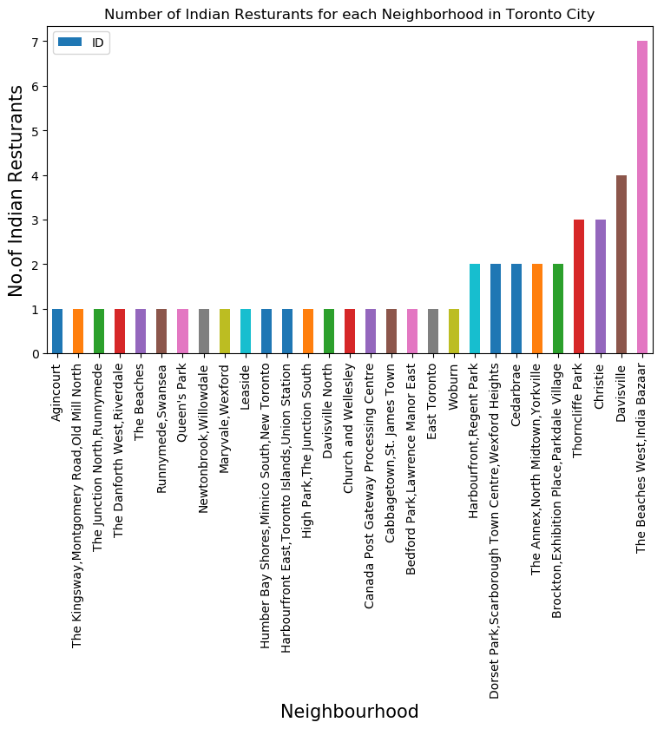
Neighbourhoods having minimum number of restaurants

Slide 7
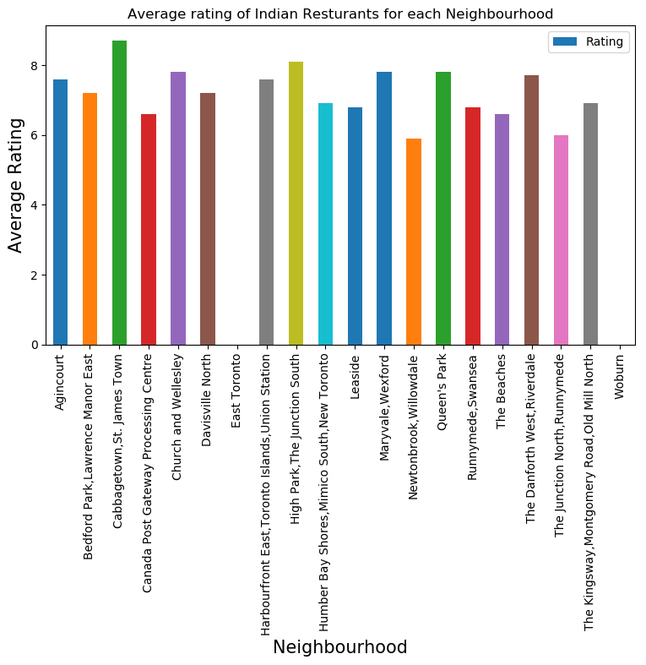
Neighbourhoods having minimum number of Indian restaurants with Top Rating for these restaurants.

Slide 8
Conclusion
Mississauga, Queen's Park and York are good places for opening Indian restaurants since there are not too many Indian restaurants in these boroughs.
The Neighbourhood 'Cabbagetown, St. James Town' has the Top rating for Indian restaurant among the Neighbourhoods having minimum number of Indian restaurants.

Slide 9
Thank You.

